Slide 1
Analysing DNA methylation & gene expression patterns in systemic lupus erythematosus (SLE)
The GINNS
Icíar Fernández Boyano
Naila Adam
Nikita Telkar
Sierra Gillis

Slide 2
01
02
03
04
Motivation and Data
QC and Normalization
Differential Analyses & Integration
Conclusions & Future Work

Slide 3
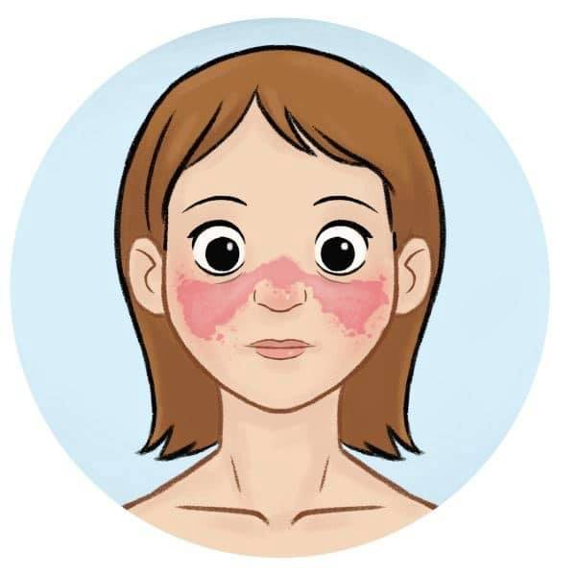
Systemic Lupus Erythematosus (SLE)
is an autoimmune chronic condition that causes inflammation in connective tissues.
multifactorial disorder: genetics & environment
9:1 female to male ratio of disease incidence
“DNA methylation (DNAm) mediates processes relevant to SLE, such as lymphocyte development and X-chromosome inactivation” (Lanata et al., 2018)
“28 confirmed disease susceptibility loci are implicated in important pathways, which contribute to SLE pathogenesis” (Guerra et al., 2012)

Slide 4
The Cohort
25 Normal Controls
15 SLE LN-
15 SLE LN+
Blood samples to get methylation and expression data
Other covariates: Age and Sex
more females than males
age ranges from 10 to 46
Expression: Illumina HumanHT-12 v4.0 Expression Beadchips
Methylation: Illumina HumanMethylation 450k BeadChip array
Raw datasets were used

Slide 5
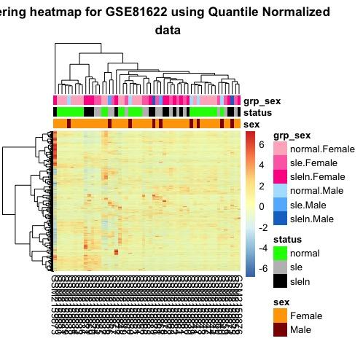
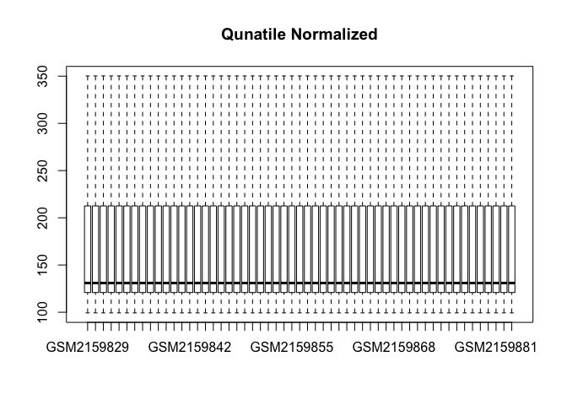
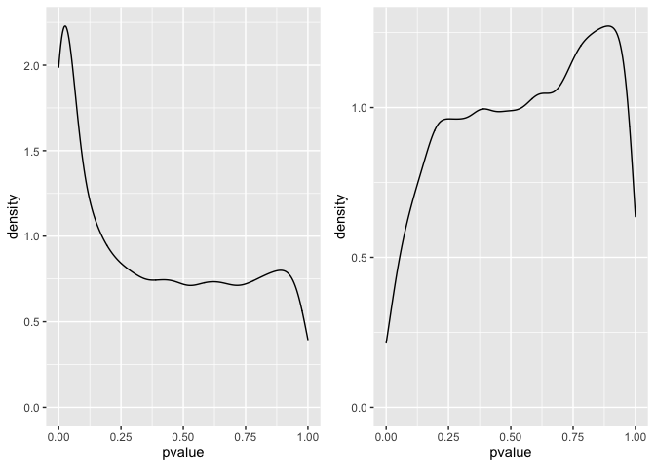
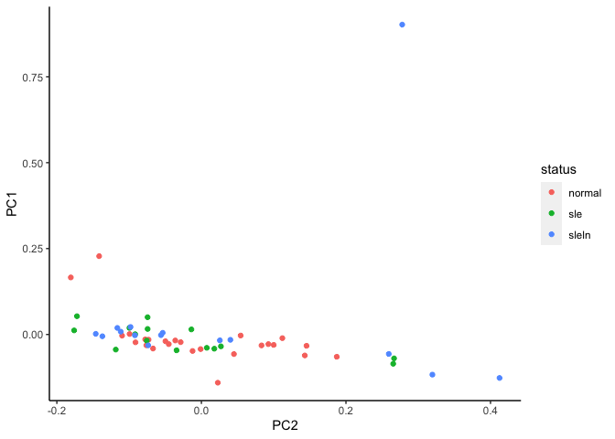
QC and Normalization - Expression Data
t-test p-values for Normal (left) vs Disease and SLE-LN+ vs SLE-LN- (right)

Slide 6
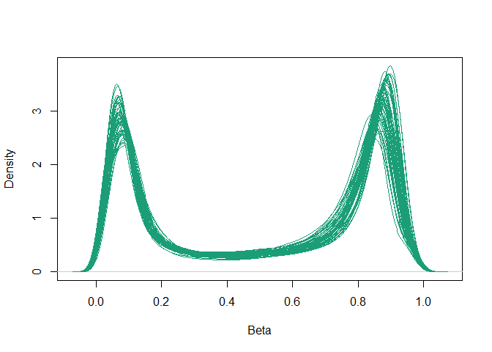
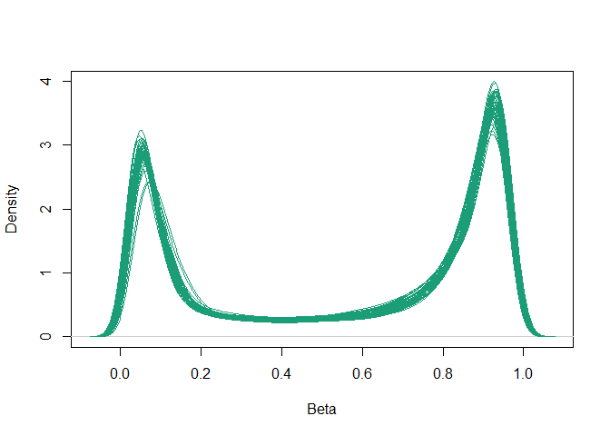
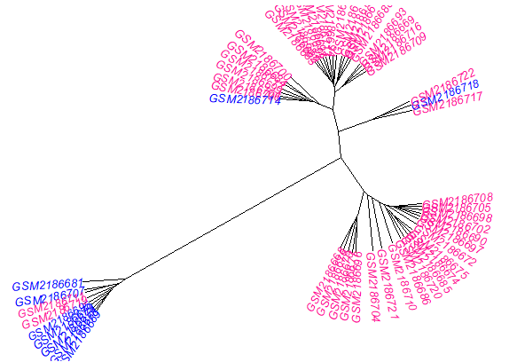
Methylation Data: Quality Control (QC) & Normalization Workflow
Pre QC & Norm
55 samples, 485577 probes
Post QC & Norm
51 samples, 345039 probes
QC Filtering
Normalization
Check sample quality
Check sample sex
Removal of:
Normalization:
Beta-Mixture Quantile (BMIQ)
wateRmelon package
SNP
Cross-hybridizing
Polymorphic
Poor quality
Non-variable
Sex
probes.
R packages used:
minfi
missMethyl
wateRmelon

Slide 7
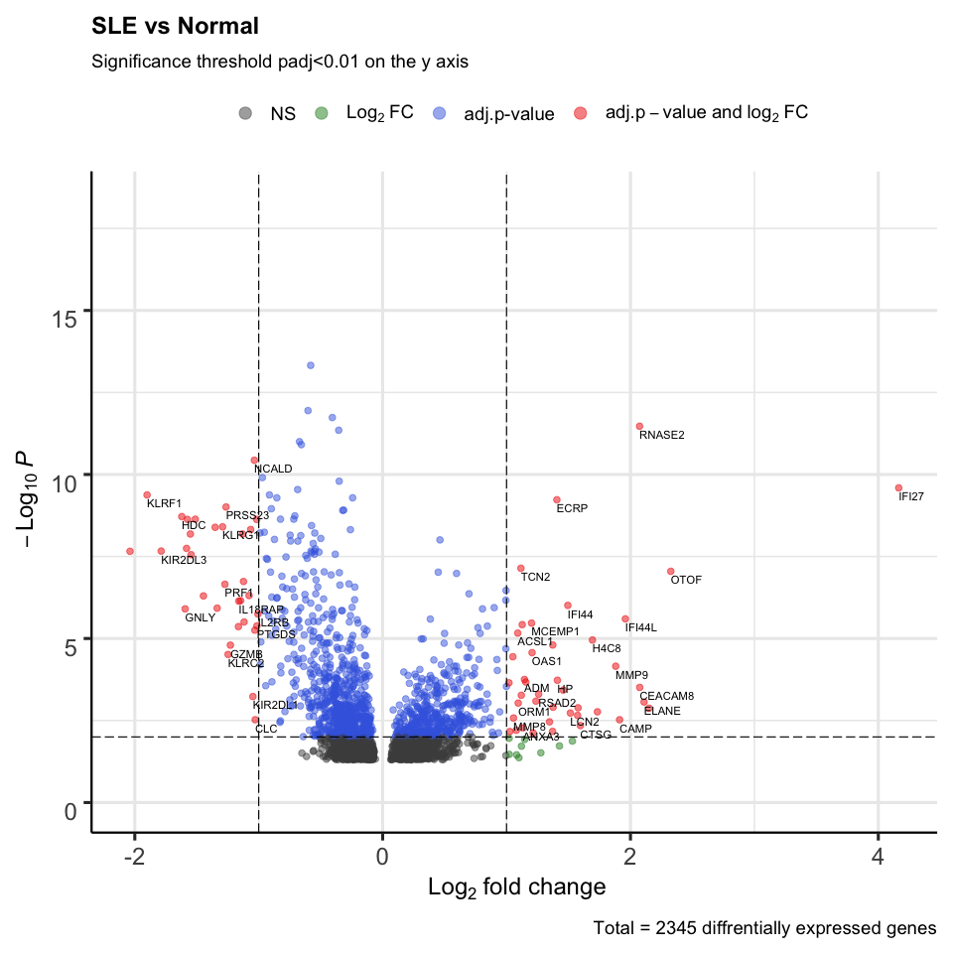
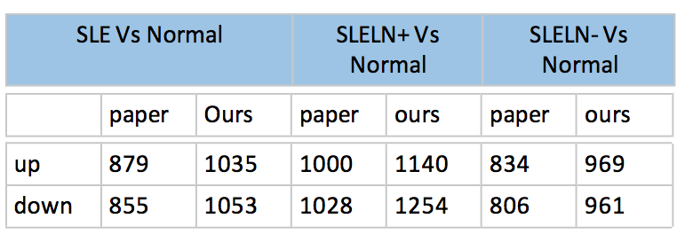
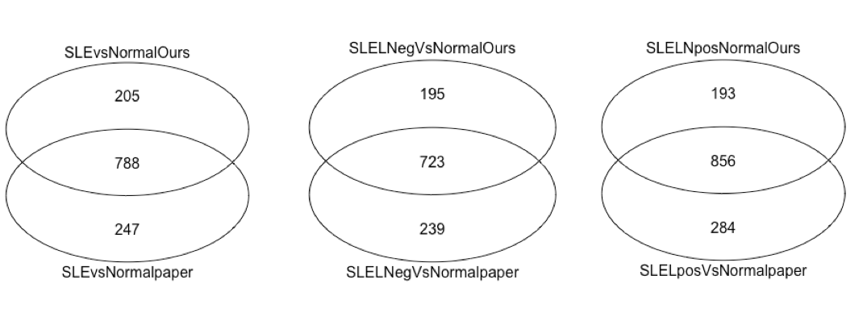
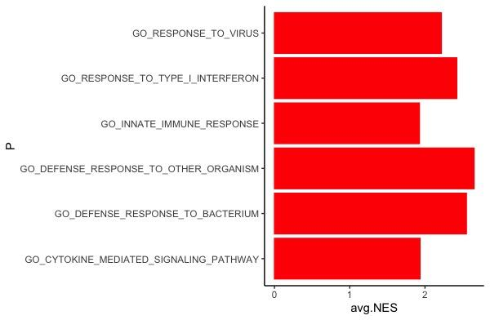
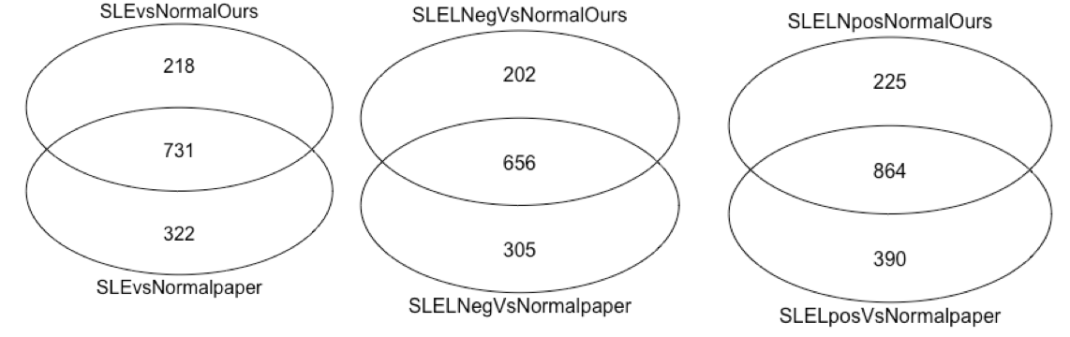
Gene Expression - Reproducing the Paper
PartA: Quantifying paper reported results
Part B:upregulation analysis( t-test)
Part B:Down regulation analysis( t-test)

Slide 8
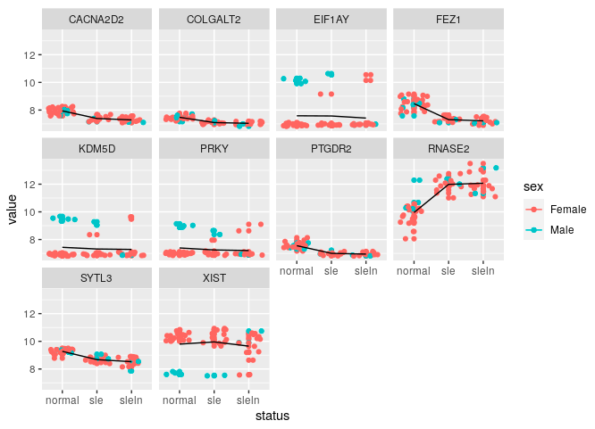
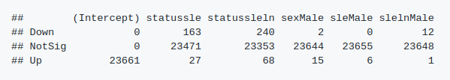
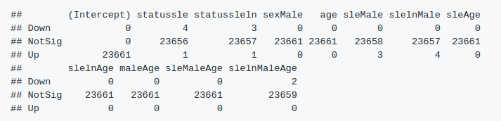
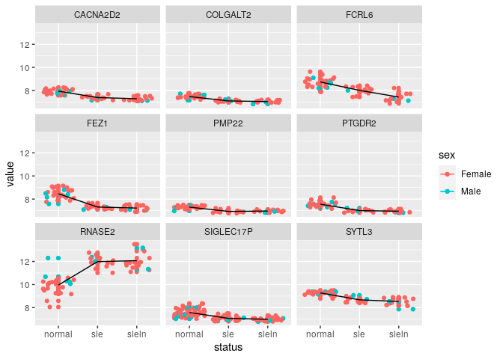
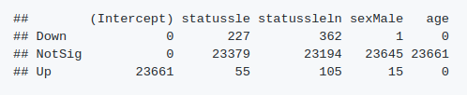
Gene Expression - Multivariate Analysis
Model 1: expression = disease status + sex + disease status * sex
Model 2: expression = disease status + sex + age + all interactions
Model 3: expression = Intercept + disease status + sex + age
Main Effects DE genes in Males vs Females: 18

Slide 9
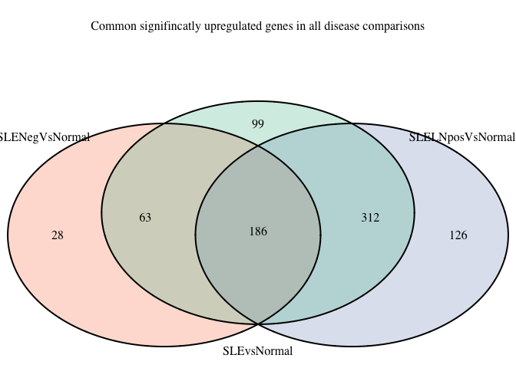
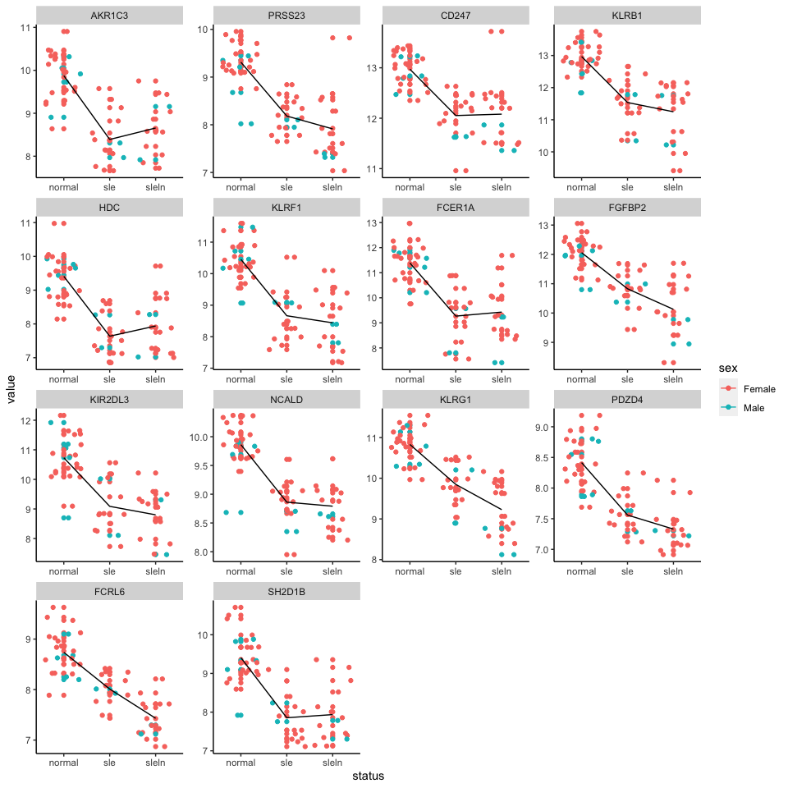
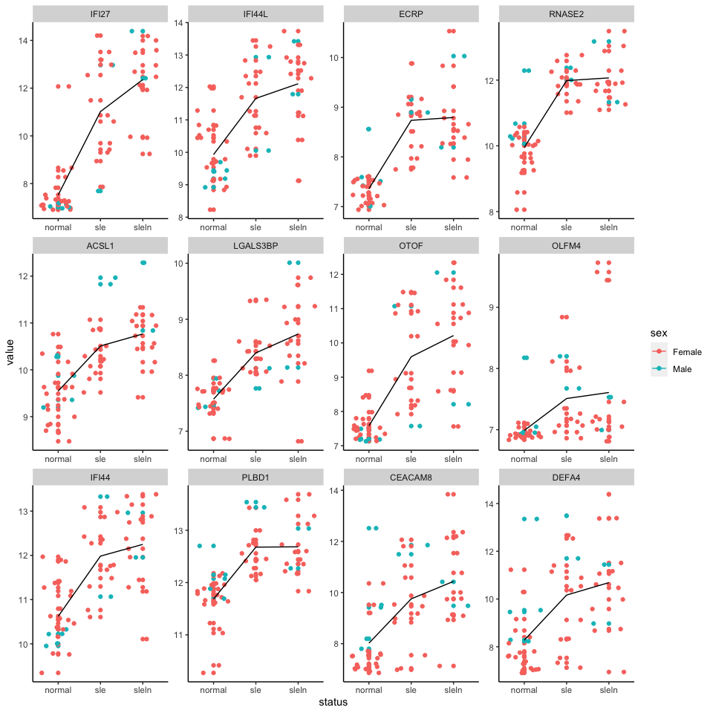
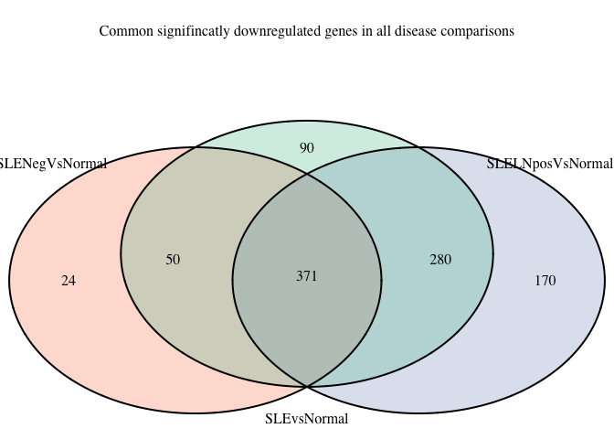
Gene Expression
model.matrix(~ status+sex+age, meta)

Slide 10
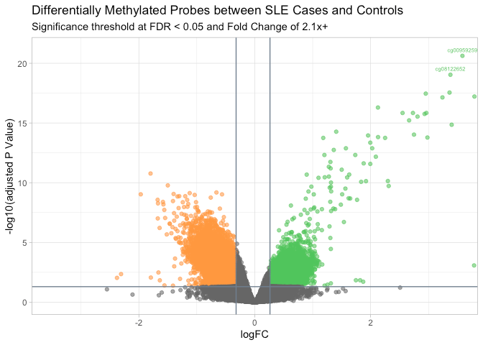
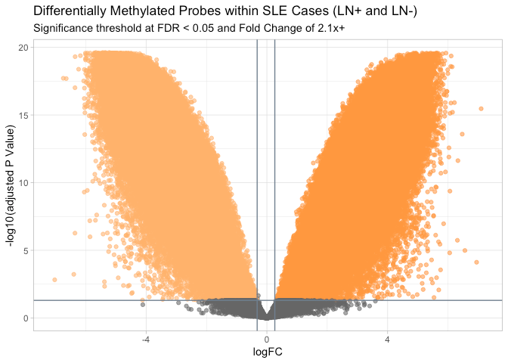
Methylation
39,247 DMPs
Hypermethylated: 10,588
Hypomethylated: 28,659
322,661 DMPs
Hypermethylated: 193,272
Hypomethylated: 129,389

Slide 11
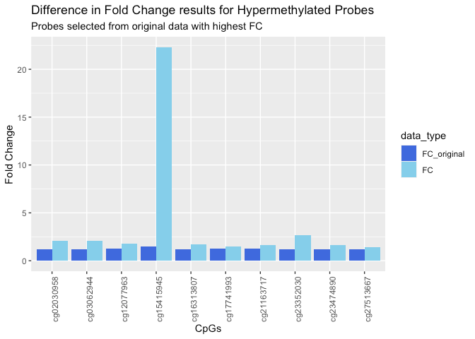
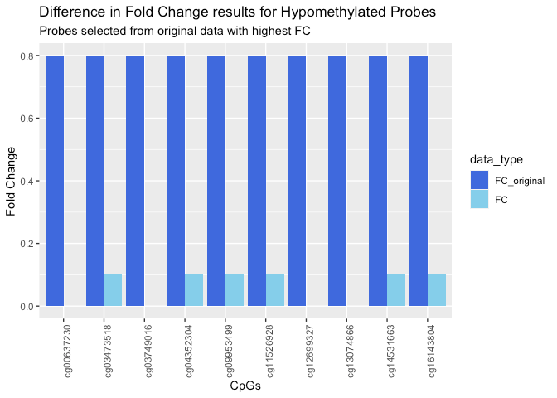
Methylation
Comparing original analysis results with ours:
hyper_probes <- sig_probes %>%
mutate (FC = 2^logFC) %>%
filter (FC >= 1.2)
hypo_probes <- sig_probes %>%
mutate (FC = 2^logFC) %>%
filter (between(sig_probes$FC, 0, 0.8))

Slide 12
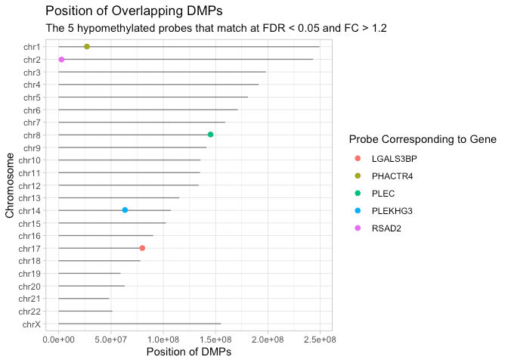
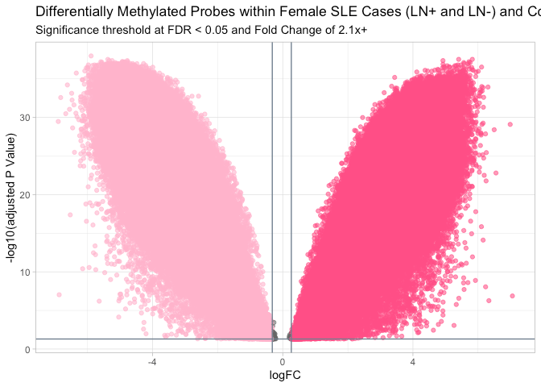
Methylation
Of 485,577 probes, 5 were reproducible by our analysis
330,794 DMPs
Hypermethylated: 198,978
Hypomethylated: 131,816

Slide 13
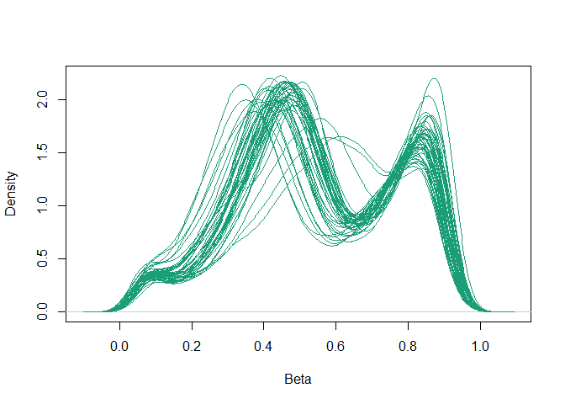
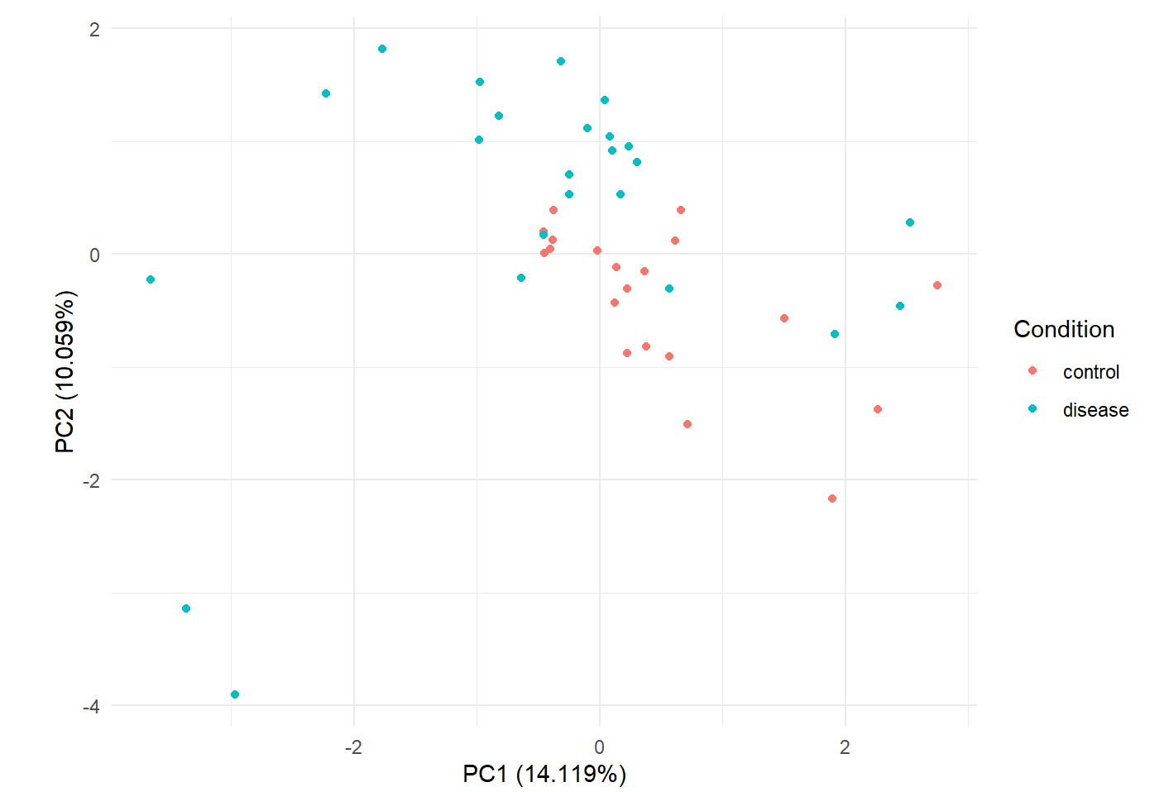
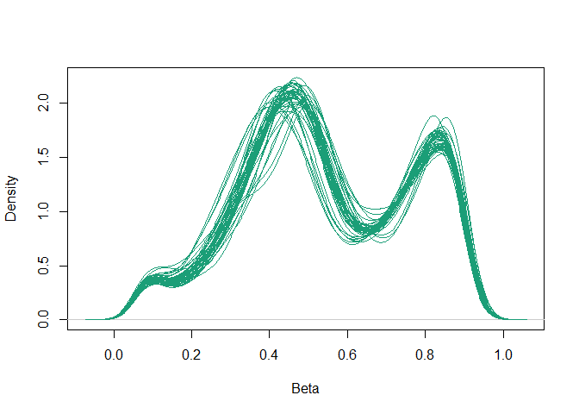
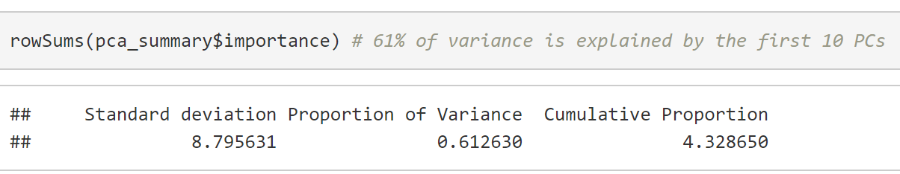
Female X-linked DNAm between cases (LN+ & LN-) & controls
Autoimmune diseases affect approximately 8% of the population, 78% of whom are women.
44 samples, 11232 probes
> remove cross-hybridizing, polymorphic,
poor-quality, and non-variable probes
> dasen normalization (wateRmelon)
QC + Norm
44 samples, 9835 probes

Slide 14
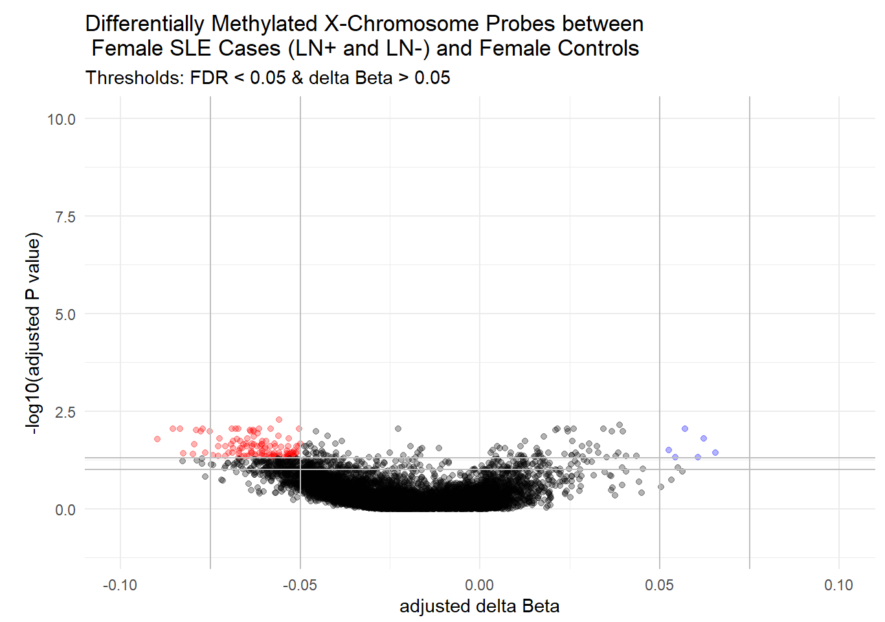
Female X-linked DNAm between cases (LN+ & LN-) & controls
model_matrix <- model_matrix(~Condition + Age, pData)
Statistical threshold FDR < 0.05
Biological threshold Δβ >=5%
120 top hits (DMPs)
model <- lmFit(m_vals, model_matrix) %>% eBayes()
calculating Δβ
avg_control <- rowMeans(control_betas)
avg_disease <- rowMeans(disease_betas)
# delta beta
diff <- (avg_control - avg_disease)
120 top hits
114 hypomethylated
6 hypermethylated
none enriched for any GO pathways in a gene ontology analysis (using gometh() in missMethyl R package)

Slide 15
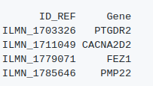


Integration
Logistic Regression
Binomial Response Variable: Normal or Disease
Disease predicted by Expression Data
Disease predicted by Methylation Data
Disease predicted by both data types

Slide 16
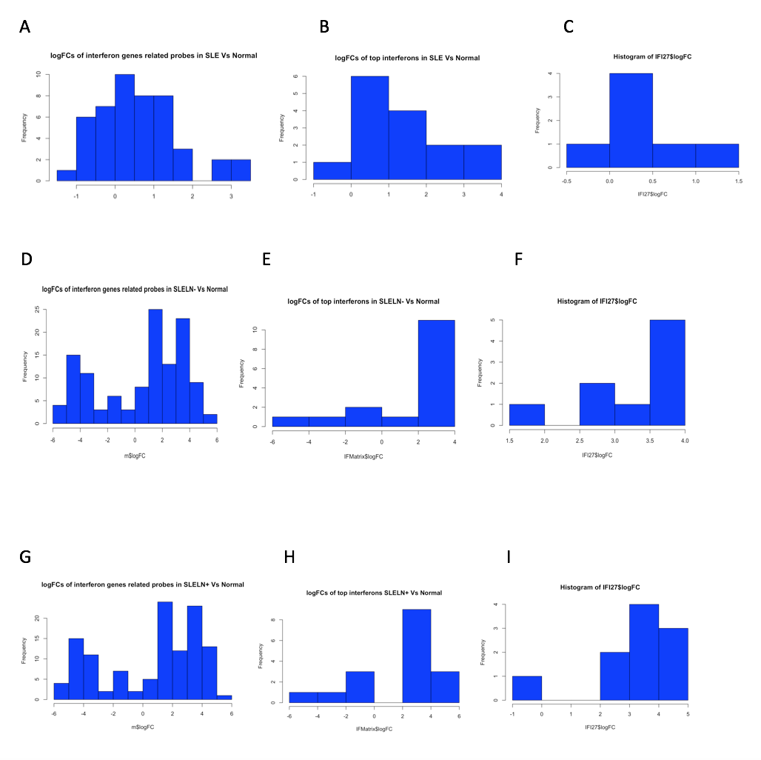
Integration
A-C: Interferon response genes differential methylation behavior in SLE vs normal.
D-F: Interferon response genes differential methylation behavior in SLELN- vs normal.
G-I: Interferon response genes differential methylation behavior in SLELN+ vs normal.
IFN genes are upregulated in gene expression analysis but don’t display hypomethylation!

Slide 17
Conclusions
Paper proved difficult to reproduce: lack of transparency in statistical analysis, inconsistencies in numbers reported in the text /supplementary, usage of plain t-test with no multiple testing correction in DE.
Pathways related to viral/bacterial infections, interferon type I, leukocyte, cytokines and granulocytes response were enriched in upregulated genes in SLE patients.
A notable downregulation in some Natural Killer genes was observed. However, no meaningful significant pathways enrichment in downregulated gene sets.
Investigating top up regulated IFNs related CpGs showed most are hypermethylated rather than hypomethylated as we expected.
Microarray studies are limited, we recommend bulk/single cell RNAseq analysis to further explore heterogeneity of SLE pathogenicity.

Slide 18
Thank you!

